Slide 1

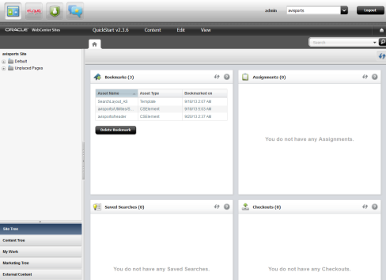
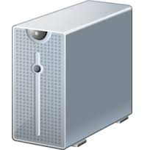
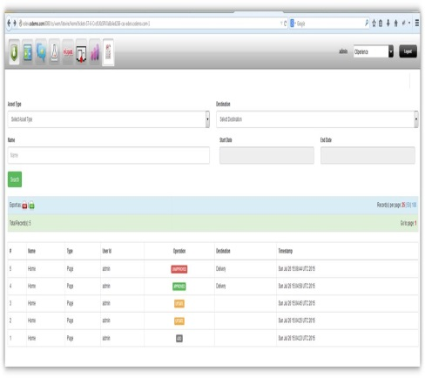



WebCenter Sites Audit – Technical Overview
Asset
Create / Update / Publish
action
WebCenter Sites
Audit Report
Asset Listeners

Slide 2
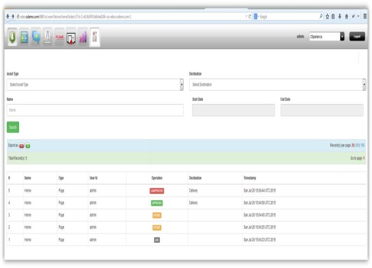
WebCenter Sites Audit – Installation Overview
Audit Reports
2
WebCenter Sites
WebCenter Audit Application
R
E
S
T
DB Services
1
Jar file to be deployed into WebCenter Sites application
Audit Application (WAR)
Audit Schema tables (SQL)
3
Audit Schema

Slide 3
WebCenter Sites Audit – Installation Package Structure
WebCenter Audit Package
ZIP
resources (folder)
webapps
libraries
ElementCatalog
source
services.war
tomcat
audit
cs
lib
WEB-INF
ojdbc7.jar
lib
sites_framework_lib.jar
wemresources

